Slide 1


Slide 2
STUDENT’S FACILITATOR

Slide 3
Project Team
Ayishm Azeem
FA16-BCS-054
Ahmad Hassan Minhas
FA16-BCS-232

Slide 4
INTRODUCTION
Provide facilities to the university students
Students can:
LEARN
EARN
SOCIALIZE

Slide 5
GOALS AND OBJECTIVES
Notes uploading and downloading facility for students
Carpooling facility available for students
Students given a platform where they can post and view ads related to hostels.
Discussion panel, where students can post their queries.
Students can earn by teaching other students.

Slide 6
Unique Selling Point (USP)
Only platform catering with all sort of facilities for the students

Slide 7
Discussion Forum
Hostels
Login
Tutors
Signup Page
Student’s Facilitator App

Slide 8
Note sharing
Carpooling
Profile

Slide 9
SCREENS

Slide 10
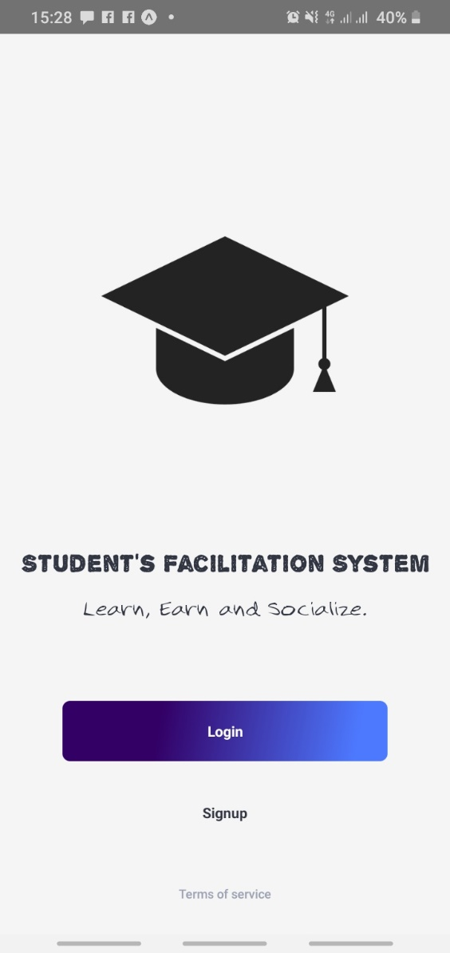
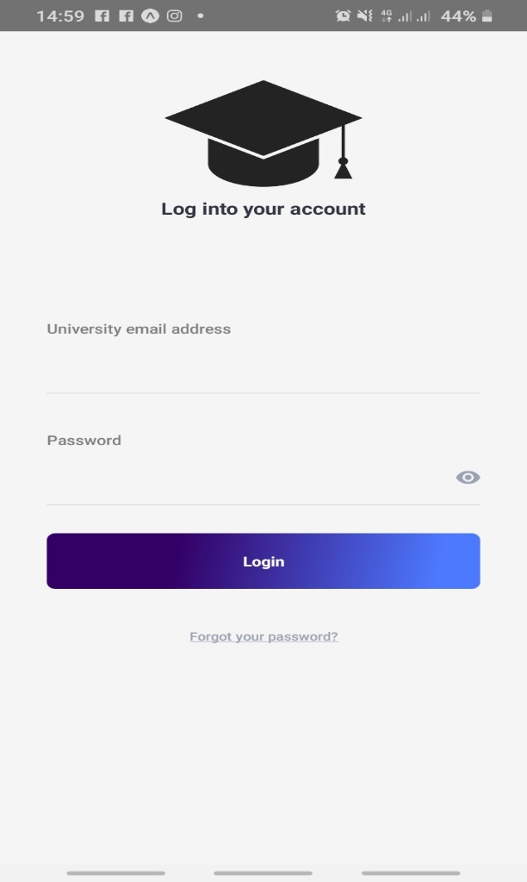
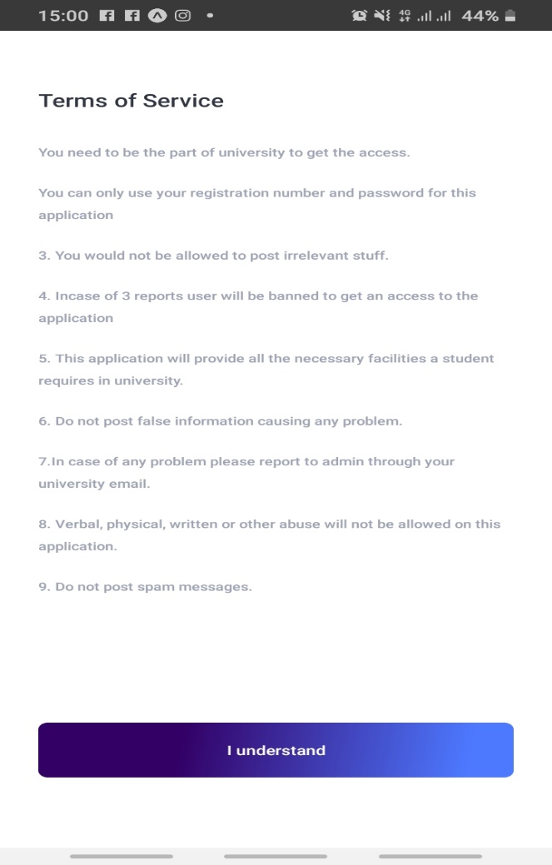

Slide 11
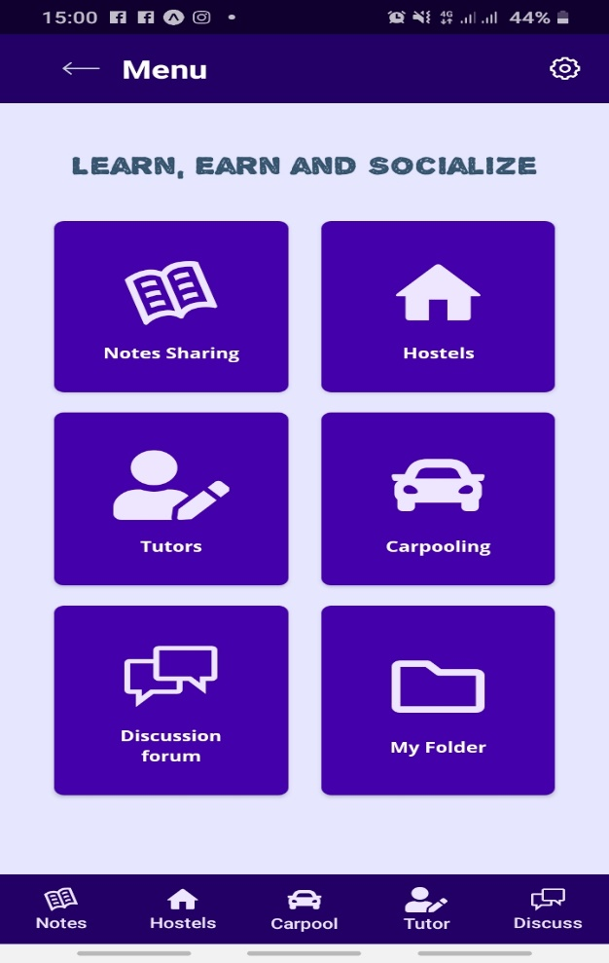
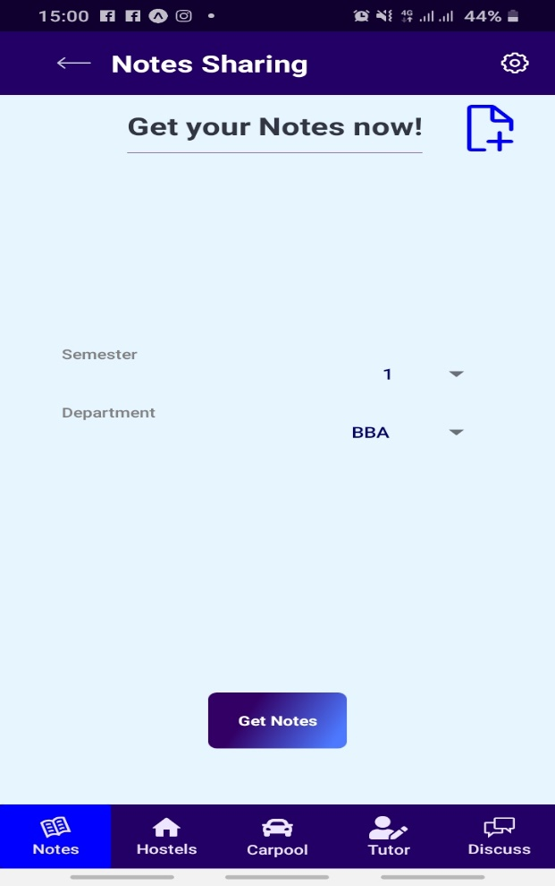
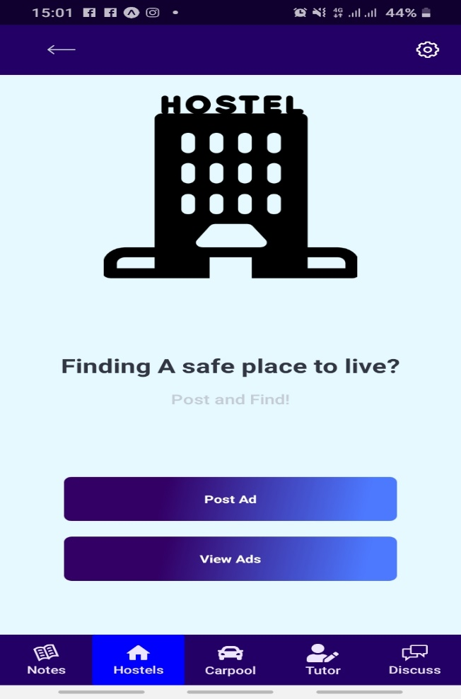

Slide 12
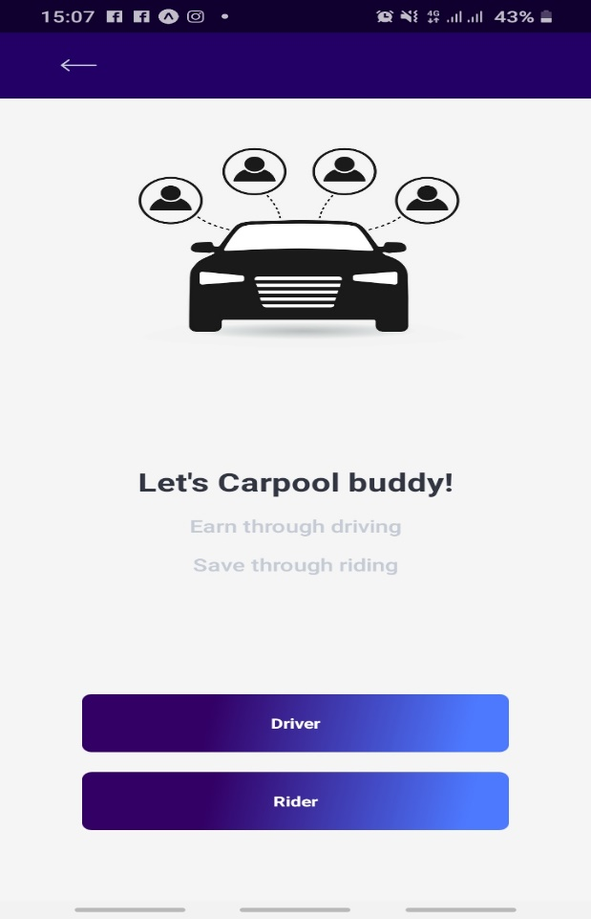
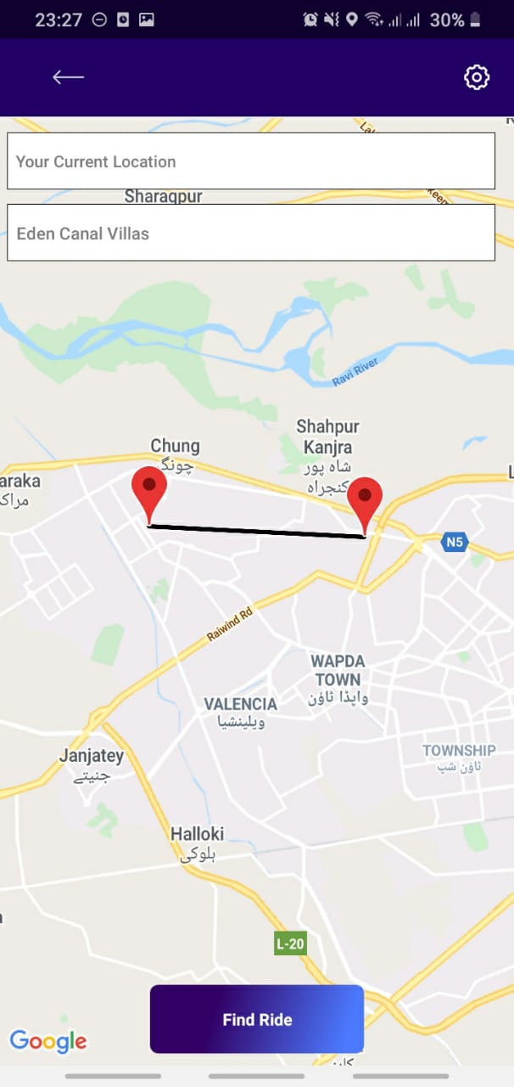
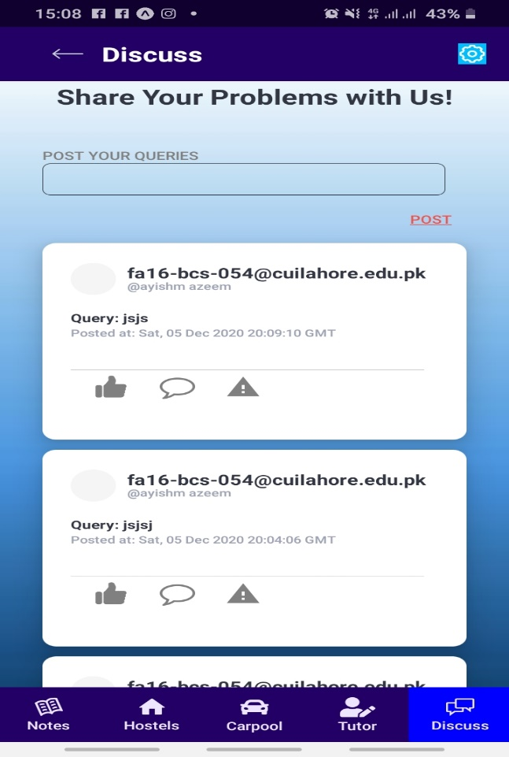

Slide 13
Problems:
Unaware of the rules and regulations, curriculum. They were helpless to get any academic assistance. conveyance issues and had to pay high fares etc.
PROBLEM STATEMENT
Solution:
We will provide organised notes of all departments, sorted according to semester, subjects It will be a solution of common problems and suggestions regarding any issues. it can be a bridge that is created among students.

Slide 14
Python Flask for backend
React-native for frontend.
MySQL database .
Technologies Used

Slide 15
Cross platform development.
Google Play store.
Apple Store.
Using the application in Universities.

Slide 16
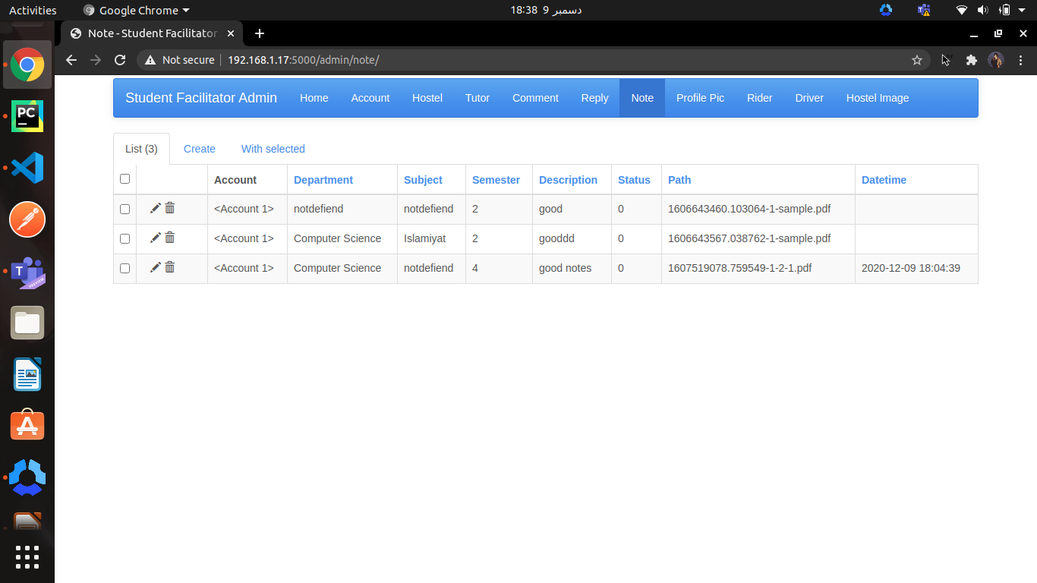
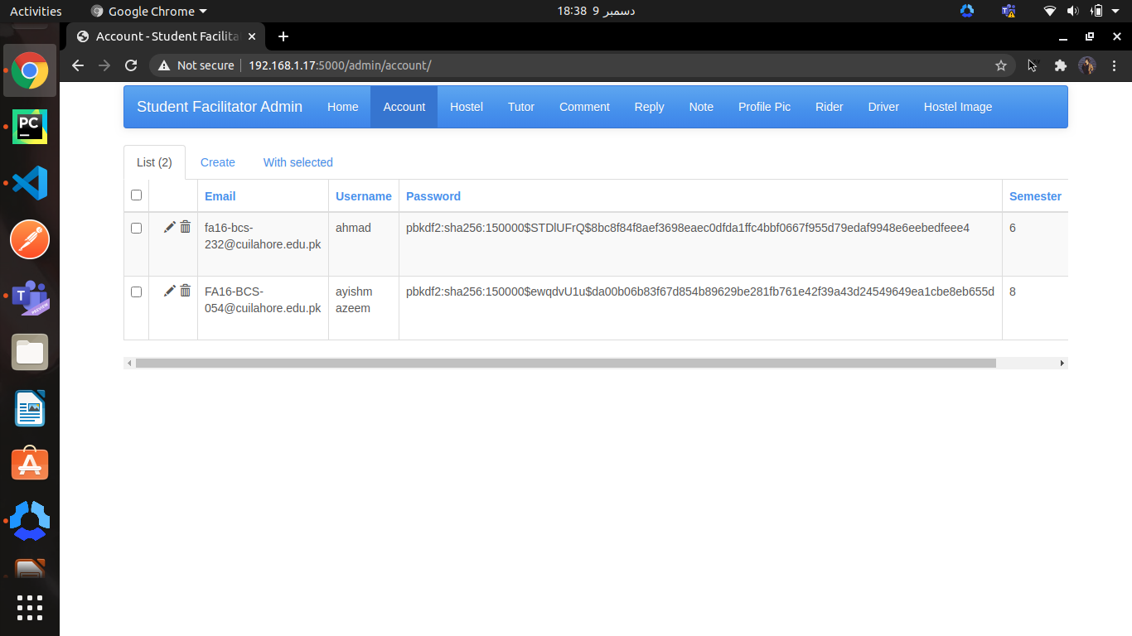
Admin Panel

Slide 17
Conclusion

Slide 18
THANK YOU!

